Slide 1
Aviation Accident Analysis and Recommendations
Help the company identify low risk aircraft MODELS that they can use to enter the aviation industry

Slide 2
Goal
Assist the company to identify which low risk aircraft they can purchase as they expand into the aviation industry.

Slide 3
Data Overview
Dataset Source:
National Transportation Safety Board (NTSB)
About the Data:
The dataset includes aviation accidents and selected incidents from 1962 to 2023, covering the United States and International waters.
Size: 90,348 entries, 31 columns.
Data Types: 26-object type, 5-float type columns.

Slide 4
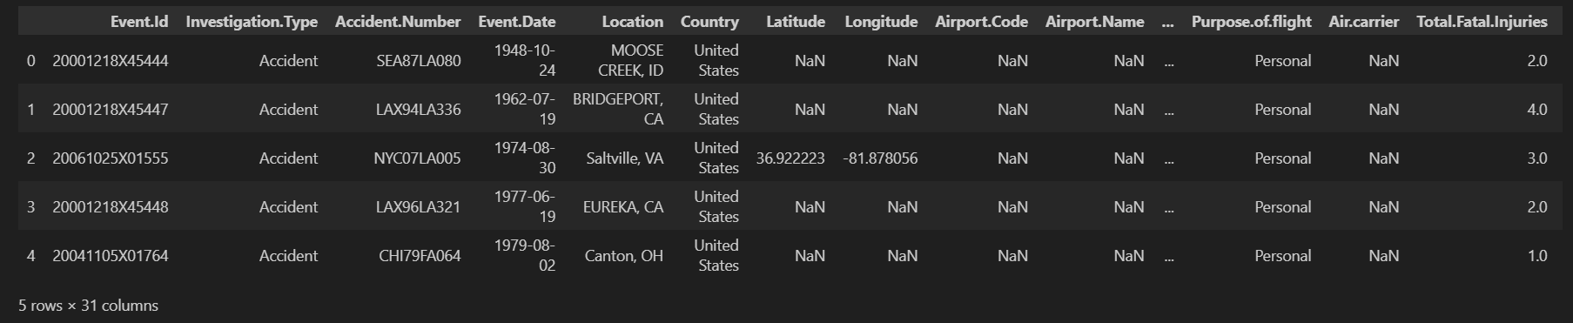
Sample of the dataset

Slide 5
Data Preparation
Steps taken
-Cleaning the data to deal with missing values.
-Analysed aircraft models to identify those with the lowest incident rates.
-Analysed total number of injuries to determine aircrafts with the lowest injury rates.
-Checked on the impact weather condition had on accident severity.

Slide 6
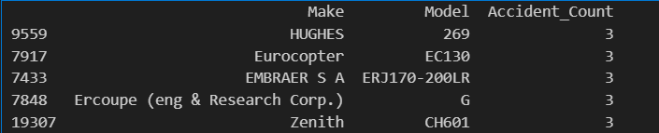
Recommendation 1 Aircraft models with the lowest accident count

Slide 7
Recommendation 1
Focus on acquiring aircraft models such as HUGHES and Eurocopter, which consistently show low accident counts.

Slide 8
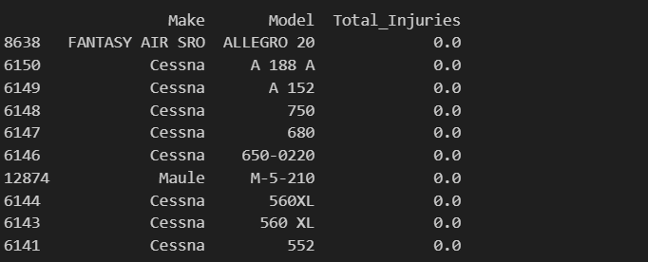
Recommendation 2 Aircraft model with lowest injuries per accident

Slide 9
Recommendation 2 Aircraft model with lowest injuries per accident
SRO and Cessna have lowAircrafts like FANTASY AIR er injury rates even when accidents occurred and are considered to be safer.

Slide 10
Recommendation 3 Aircraft operations in different weather conditions
Avoid flight operations under IMC as most fatal accidents occur during poor weather.

Slide 11
Q&A Session
Are there any questions?
Contact Information:
Name: Jenipher Oduor
Email: jenipheroduor@gmail.com
LinkedIn: www.linkedin.com/in/jenipher-oduor
Thankyou.

